Slide 1
Structure Programming
ICT-1105
Information and Communication Technology
Lecture-01

Slide 2
References & Books:
E. Balagurusamy, Programming in ANSI C
Herbert Schildt, The Complement Reference of C
Byron S. Gottfried ,Theory and Problems of Programming with C
C Kernighan & D.M. Ritchie, The C programming Language
Herbert Schild, Teach Yourself C

Slide 3
Computer systems
A Computer is an electronic device which performs operations such as accepts data as an input, store the data, manipulate or process the data and produce the results an output.

Slide 4
Computer systems
Main task performed by a computer
• Accept the data
• Process or manipulate the data
• Display or store the result in the form of human understanding
• Store the data, instructions and results.

Slide 5
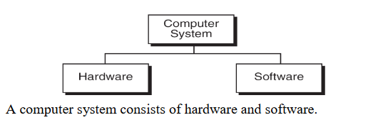
Computer systems

Slide 6
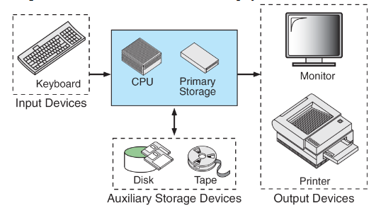
Computer systems
Computer hardware is the collection of physical elements that comprise a computer system.

Slide 7
Computer systems
Computer software is a collection of computer programs and related data that provides the instructions for a computer what to do and how to do it.
Software refers to one or more computer programs and data held in the storage of the computer for some purpose.

Slide 8
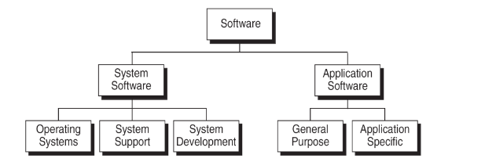
Computer systems

Slide 9
Computer systems
Basically computer software is of three main types
  System Software
  Programming Software
  Application Software

Slide 10
Computer systems
System Software: System software is responsible for managing a variety of independent hardware components, so that they can work together. Its purpose is to unburden the application software programmer from the often complex details of the particular computer being used, including such accessories as communications devices, printers, device readers, displays and keyboards, and also to partition the computer's resources such as memory and processor time in a safe and stable manner.

Slide 11
Computer systems
System Software Example:
• Device drivers
• Operating systems
• Servers
• Utilities
• Window systems

Slide 12
Computer systems
Programming Software: Programming Software usually provides tools to assist a programmer in writing computer programs, and software using different programming languages in a more convenient way.
The tools include:
• Compilers
• Debuggers
• Interpreters
• Linkers
• Text editors

Slide 13
Computer systems
Application Software: Application software is developed to aid in any task that benefits from computation. It is a broad category, and encompasses Software of many kinds, including the internet browser being used to display this page.
This category includes:
• Business software
• Computer aided design
• Databases
• Decision making software
• Educational software
• Image editing

Slide 14
Computing Environment
Computing Environment is a collection of computers / machines, software, and networks that support the processing and exchange of electronic information meant to support various types of computing solutions.

Slide 15
Computing Environment
Types of Computing Environments:
Personal Computing Environment
Client Server Environment
Time sharing Environment
Distributed Environment

Slide 16
Personal Computing Environment
All of the computer hardware components are tied together in our personal computer. A personal computer (PC) is a computer whose original sales price, size, and capabilities make it useful for individuals, and intended to be operated directly by an end user, with no intervening computer operator. People generally relate this term with Microsoft’s Windows Operating system. Personal computers generally run on Windows, Mac or some version of Linux operating system.
Desktop: Desktop computer is just another version of Personal Computer intended for regular use from a single use. A computer that can be fit on a desk can also be called as desktop.

Slide 17
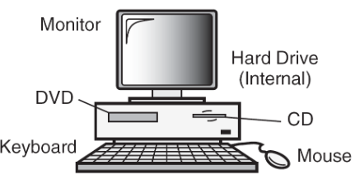
Personal Computing Environment

Slide 18
Time-Sharing Environment
In the time-sharing environment, all computing must be done by the central computer. The central computer the shared resources, it manage the shared data and printing.
Employees in large companies often work in what is known as time sharing environment. In the time sharing environment, many users are connected to one or more computers. These computers may be minicomputers and central mainframes. In this environment the output devices, auxiliary storage devices are shared by all the users.

Slide 19
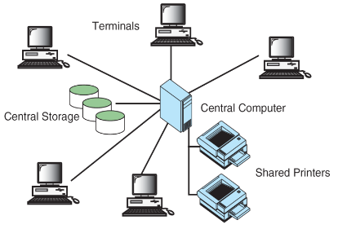
Time-Sharing Environment

Slide 20
Client/Server Environment
Client/Server computing environment splits the computing function between a central computer and user’s computers.
The users are given personal computers or work stations so that some of the computation responsibility can be moved from the central computer and assigned to the workstations.
In the client/server environment the users micro computers or work stations are called the client. The central computer which may be a powerful micro computer, minicomputer or central mainframe system is known as server.

Slide 21
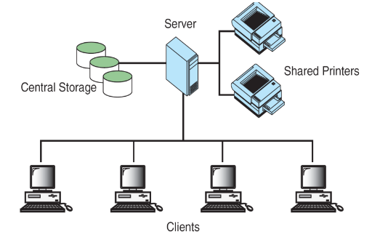
Client/Server Environment

Slide 22
Distributed Computing Environment
A distributed computing environment provides a seamless integration of computing functions between different servers and clients. The internet provides connectivity to different servers throughout the world. This environment provides reliable, scalable and highly available network.

Slide 23
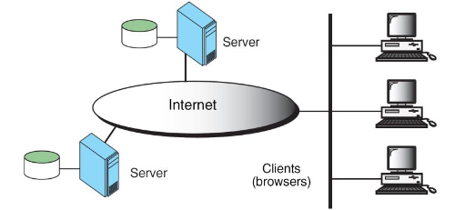
Time-Sharing Environment

Slide 24
Thank you….

